Slide 1
E-Electronics E-Commerce Application
Saranya Chithalandur Rajendran
Vimala Donagiri

Slide 2
OVERVIEW
E-Electronics is an e-Commerce web application
Provides categorization of products
All kind of products can be viewed in one place
Products can be filtered based on product category
Provides a search textbox for quick search
Allows to user the add item into a wish list for feature
Offers the following essential e-Commerce functionalities: Shopping cart, checkout, User login, Order history.

Slide 3
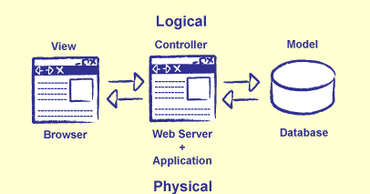
Architecture
Three tier architecture used to implement the application.

Slide 4
Three Tier
PRESENTATION TIER: HTML5, CSS3, JSP for user interface, Bootstrap,JQuery ,Google fonts .
APPLICATION TIER: Tomcat 7,Servlets.
DATA TIER : Eclipse Link JPA, MySQL.

Slide 5
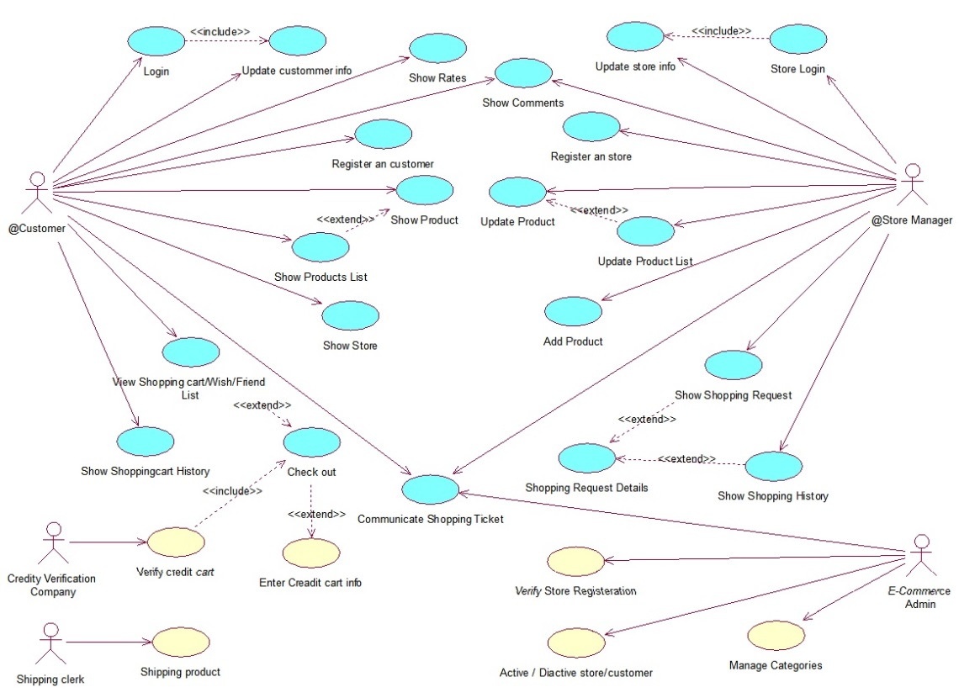
Use case diagram

Slide 6
DATA BASE
Data base hosted on MYSQL server:-
Schema name: e-comdb
Tables: Address
Category
Order-header
Order-line
Product
Review
Subscriber
User
Wish-item

Slide 7
DEMO

Slide 8


